Slide 1

Design Sprint
Amir Dirin 2023
https://www.fraktio.fi/blogi/mika-design-sprint?utm_source=linkedin&utm_medium=paidsocial&utm_campaign=remarketing&utm_content=designsprint&hsa_acc=508088359&hsa_cam=625005506&hsa_grp=192494806&hsa_ad=221458476&hsa_net=linkedin&hsa_ver=3&li_fat_id=021c1b6b-2ff7-4f0c-8f02-ded059926f6a

Slide 2
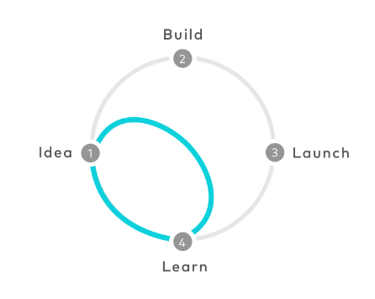
Designer helps you get your point across
The sprint is a five-day process for answering critical business questions through design, prototyping, and testing ideas with customers
Developed by https://www.gv.com/
Shorter time to come up with a concept vs. UCD
Understand the need
Come up with a realistic prototype

Slide 3





The Process
How it works:
1
Map out the problem and pick an important place to focus
2
Sketch competing solutions on paper
3
Convert the idea as testable hypothesis
4
Design the high-fidelity prototype
5
Test the prototype

Slide 4
First Day
Agree with the team member on a long –term goal.
Make a map of the challenge
Ask the experts what they know about the challenges
Pick a manageable piece of the problem that you can solve
https://www.gv.com/sprint/

Slide 5
Second Day
1
Focus on the solution
2
Improve the existing ideas. Each person in the team sketch using critical thinking
3
Plan the customer test by recruiting customers

Slide 6
Third Day
You have a stack of potential solutions
1
Each person critique each solution
2
Decide which ones have the best chance of achieving your long term goal.
3
…Take winning scenes from the sketches and weave them into a storyboard.

Slide 7
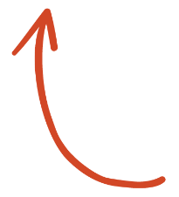
Forth Day
Convert the storyboard into high fidelity prototype. Try it:
SELECT ME
1
Test the prototype with customers, Focus on the customer-facing surface of your product or service.
2
Make sure the test plan is ready for the next day such as schedule, reviewing the prototype and writing an interview script.
3

Slide 8
Fifth day
Build the realistic prototype. Try it:
1
Conduct interview with customer and learn their reaction to your prototype

